Slide 1
Old Church Otters Swim Team
Use this digital handbook to learn all about the OC Otters Swim Team!
Swim Team Handbook

Slide 2
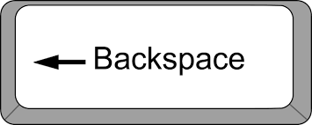
Quick Access
NAVIGATING THE HANDBOOK
CLICK ON THIS IMAGE IN THE TOP RIGHT CORNER OF THE SCREEN TO RETURN TO THE TABLE OF CONTENTS
WELCOME & CONTACTS
(PAGES 1-8)
TIME TO VOLUNTEER!
(PAGES 59-72)
MEET THE COACH
(PAGES 9-12)
CONCESSIONS
(PAGES 73-80)
USE THE RIGHT ARROW OR UP ARROW ON YOUR KEYBOARD TO MOVE TO THE NEXT PAGE
REGISTRATION
(PAGES 13-20)
LET’S CELEBRATE!
(PAGES 81-84)
CLICK WITH YOUR MOUSE OR PRESS THE SPACEBAR TO ADVANCE TO THE NEXT PAGE
SWIM TEAM APPAREL
(PAGES 21-28)
TIME STANDARDS
(PAGES 85-88)
PRACTICE SCHEDULE
(PAGES 29-34)
READING THE RESULTS
(PAGES 89-100)
USE THE LEFT ARROW OR DOWN ARROW ON YOUR KEYBOARD TO MOVE TO THE PREVIOUS PAGE
MEET SCHEDULE & DETAILS
(PAGES 35-50)
CHAMPS
(PAGES 101-104)
PRESS THE BACKSPACE BAR TO MOVE TO THE PREVIOUS PAGE
INCLEMENT WEATHER
(PAGES 51-58)
SPONSORSHIPS
(PAGES 105-107)

Slide 3
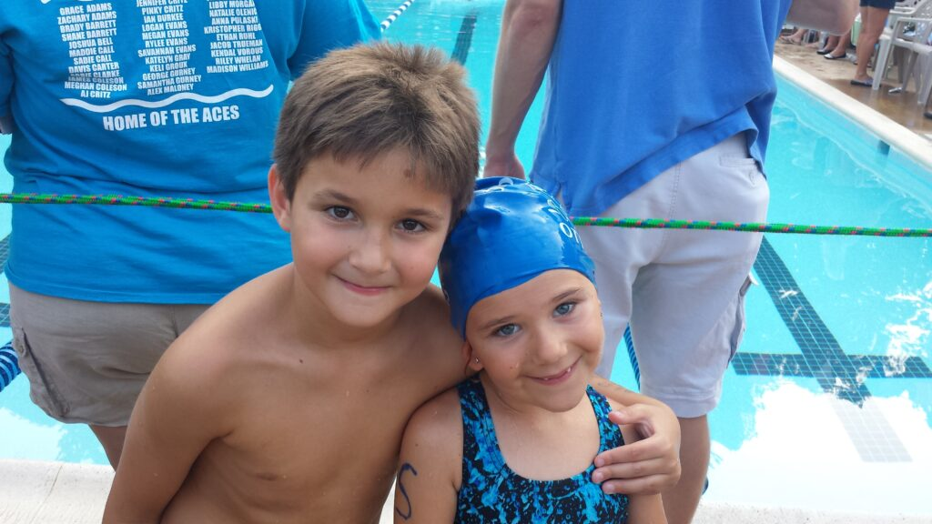
WELCOME
The Old Church Community Center sponsors a swim team to provide an environment that fosters fun, fitness, proper swimming technique, and competition. Team participation promotes sportsmanship, self-esteem, self-discipline, accountability, and social interaction among a wide variety of age groups.
Our goal is to encourage swimmers to strive for personal excellence in a spirit of goodwill and fair play.
Keep Swimming To the Next Page for More Info
1
2
CLICK HERE

Slide 4
WELCOME
To qualify for swim team, a swimmer’s family must be in good standing with Old Church Community Center - meaning dues are paid in full.
Swimmers must be competent at making it unassisted for one length of the pool (25 yards) at the end of the first week of practice.
The OC Otters offer a competitive swimming program for swimmers age 5 to 18. Our coaches strive to implement proper swimming technique while improving efficiency in each athlete throughout their swimming experience.
Keep Swimming To the Next Page for More Info
3
4
CLICK HERE

Slide 5
WELCOME
The final determination is decided by the coaching staff in collaboration with the swim team liaison (an official Old Church Community Center Board member for the swim team).
The first week of practice is a “trial” week for new swimmers, and allows the coaches to work with each swimmer in order to gauge proficiency, safety, and improvement in the water.
Please join us in supporting our children and dedicated coaches and parents for the 2023 swim season.
Our expectation is that all spectators will act as positive role models, creating a friendly and uplifting environment for both our team and the visiting teams.
Keep Swimming To the Next Page for More Info
5
6
CLICK HERE

Slide 6
CONTACTS
Contact Information
Head Coach: Courtney Hurtubise, ocswimteam@gmail.com
OC Board Liaison: Amy Owen, arowen1@gmail.com
OC Board President:
Jim Hurtubise, jimhurtubise8704@gmail.com
The Old Church Community Center swim team is a member of the Greater Richmond Aquatic League (GRAL). We abide by the rules of this league as well as our community center by-laws. Information about GRAL can be found on their website, including their mission, divisions and division times, meet schedule, top times of the season, Champs qualifying times, records and more.
www.gralva.com
7
8

Slide 7
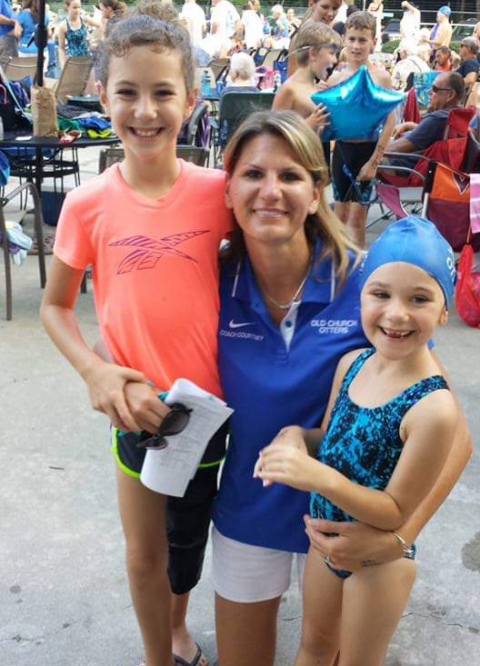
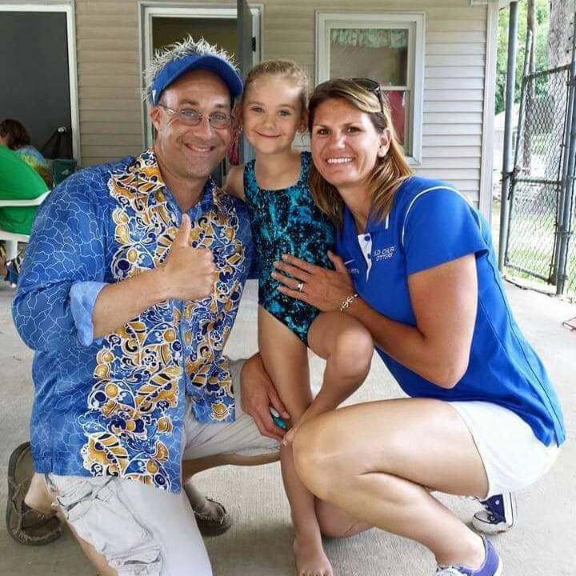
MEET THE COACH
Courtney Hurtubise is in her 11th year as Head Coach of the Old Church Otters. She has been a competitive swimmer since she was five years old - swimming summer league, high school, and as a Division 1 athlete for the University of Tennessee.
Her coaching experience dates back to 2003, with experience as both a summer league coach and high school swimming coach.
As a coach, Courtney spends time focusing on teaching the proper techniques for the four competitive strokes while also encouraging athletes to grow out of their comfort zone and reach new heights.
Courtney and her husband, Jim, are passionate about serving Old Church Community Center and currently have two daughters on the swim team, with a son that is hoping to join the team this summer!
Keep Swimming To the Next Page for More Info
9
10
CLICK HERE

Slide 8
MEET THE COACH
COMING SOON!
11
12

Slide 9
REGISTRATION
Early Bird Registration
Now - April 21, 2023
$100 first swimmer, $75 each additional swimmer
Regular Registration
April 22 - May 31 , 2023
$125 first swimmer, $75 each additional swimmer
Late Registration
June 1, 2023
$150 first swimmer, $75 each additional swimmer
Families interested in registering a swimmer for the OC Otters swim team can do so through the mail, or in person.
Old Church Community Center
PO BOX 182
Mechanicsville, VA 23111
Access the 2023 Registration Form Below:
2023 Registration Form
**Please Note**
that before a swimmer can
register for swim team, membership dues for the year must be paid in full.
Keep Swimming To the Next Page for More Info
13
14
CLICK HERE

Slide 10
REGISTRATION
During in-person registration, you will have the chance to:
meet the coaches
complete forms and provide payment for swim team (Venmo, cash, check accepted)
try on and order swim team apparel (suit and goggles)
sign up for volunteer opportunities
learn more about the OC Otters swim team
In-person Registration Opportunities:
April 21, 2023
5:00 - 7:00 PM
OCCC Clubhouse
May 26, 2023
6:00 PM - 7:00 PM
OCCC Clubhouse
Keep Swimming To the Next Page for More Info
15
16
CLICK HERE

Slide 11
REGISTRATION
swimmer’s primary care doctor
(please be ready to provide name, and phone number)
any allergies or medical issues that the coaching staff needs to be aware of
When registering a swimmer for swim team, please be ready to provide the following information:
swimmer’s name (first, last, middle initial) and date of birth
swimmer’s t-shirt size
contact information for family members wishing to receive swim team communications (emails & phone numbers)
Keep Swimming To the Next Page for More Info
17
18
CLICK HERE

Slide 12
REGISTRATION
OPTIONAL INVESTMENTS
TEAM SUIT | ~ $60
GOGGLES | ~ $20
GOGGLE BUNGEE | ~ $5
SWIM CAP | $5
SWIM FINS (RECOMMENDED FOR 8 YEARS AND UNDER SWIMMERS) | ~ $25
KICK BOARD | ~ $15
FUN FRIDAY | ~ $5 PER FRIDAY (in form of food donation only if participating)
BANQUET | ~ $15 PER FAMILY (in form of food donation only if participating)
CHAMPS SHIRT & SWIM CAP | $27 ($15 SHIRT / $12 CAP)
SWIM-A-THON | YOU DECIDE
SWIM TEAM SWAG | YOU DECIDE
Financial Investment Breakdown
REQUIRED INVESTMENTS
MEMBERSHIP | PAID IN FULL
REGISTRATION | Early Bird ($100 first swimmer, $75 each additional swimmer) Regular ($125 first swimmer, $75 each additional swimmer) Late ($150 first swimmer, $75 each additional swimmer)
CONCESSION DONATIONS | $50 (Venmo/Cash/Check - OR - food/drink donations at each of the 3 home meets)
19
20

Slide 13
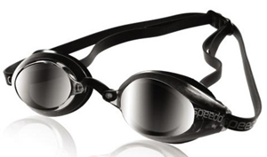
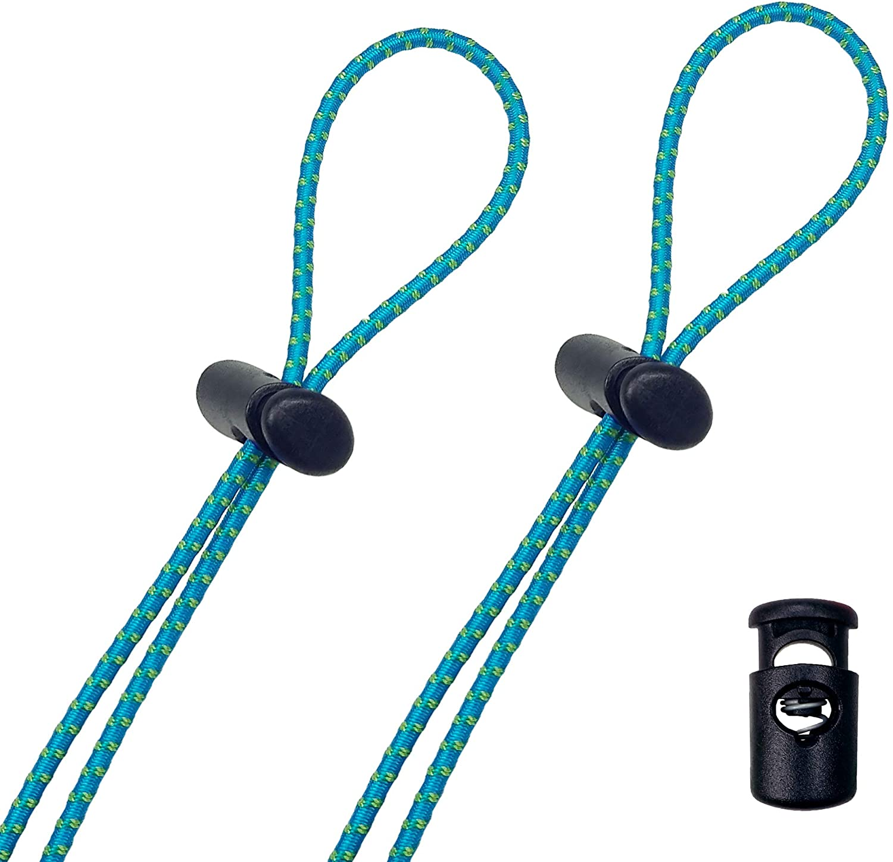
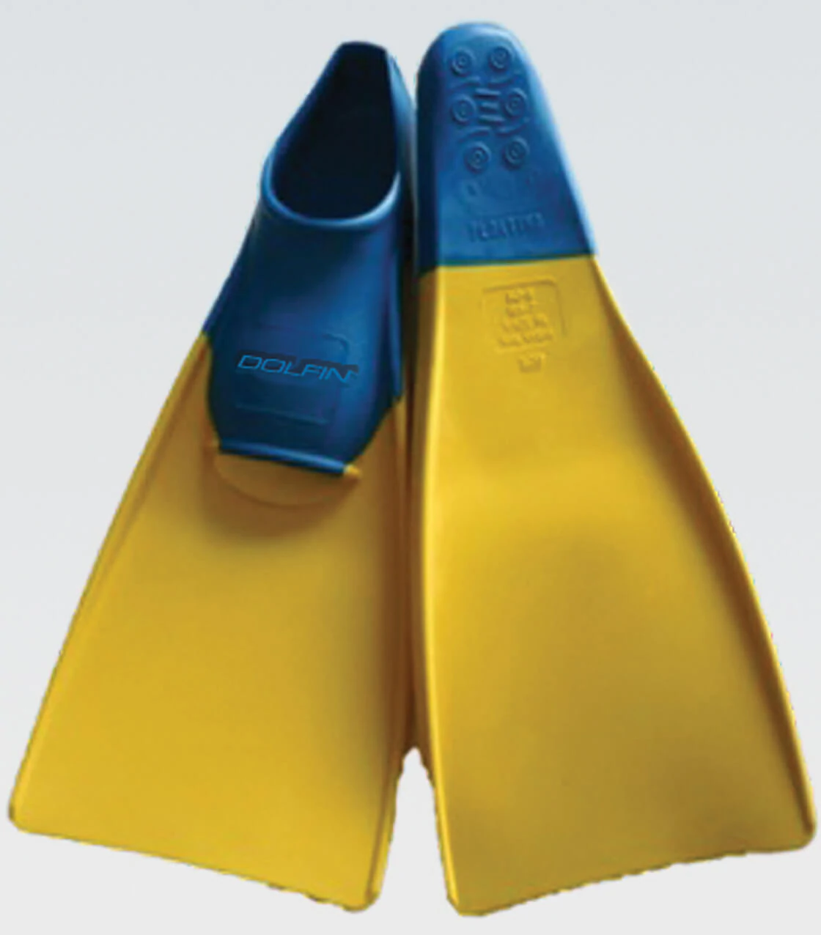
SWIM TEAM APPAREL
Quality Competition Goggles:
Proper competition goggles are more functional in a competitive setting and last longer than standard
goggles. We recommend
name brands like Speedo
and TYR.
Goggle Bungees:
Bungees allow the transition
time from the “training”
setting to the “competition” setting to occur more efficiently during practices and meets, and tremendously reduces typical goggle issues during diving.
Recommended Swim Apparel
(Not Mandatory)
Swim Fins:
Swim fins are used regularly during practice. While we do have some on site, they are well loved and not in the best shape. We recommend that 8 and under swimmers have their own
fins to ensure proper fit.
If you need help with
sizing, please see a
coach.
Keep Swimming To the Next Page for More Info
21
22
CLICK HERE

Slide 14
SWIM TEAM APPAREL
Female team suits tend to run around $53, and male suits around $35.
If you choose not to purchase a team suit, please do your best to find a swimsuit that closely matches our OC Otter colors of royal blue and black.
Whether at practice or during a meet, all suits worn should be a fitted, competitive style suit.
(no ruffles, tankinis or board shorts)
CLICK HERE TO ORDER A SWIM TEAM SUIT
Registered swimmers receive a free OC Otters t-shirt with all Otters’ names printed on the back!
At swim team registration, our suit vendor will be on site to size and sell our team suits, as well as goggles, goggle bungees and other optional swim paraphernalia. Our team suits are used for a two-year cycle, so if suits are worn only at meets (which is recommended), they should last two summers, unless the swimmer outgrows it.
Purchasing any swim team apparel is always optional.
Keep Swimming To the Next Page for More Info
23
24
CLICK HERE

Slide 15
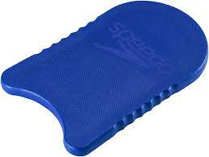
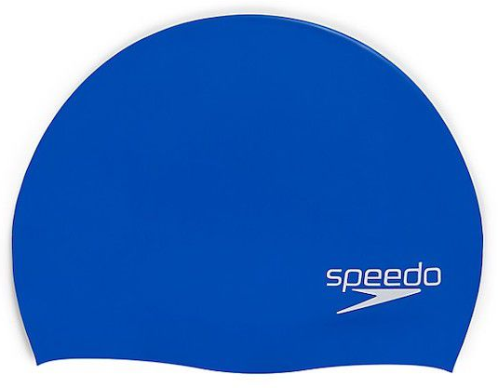
SWIM TEAM APPAREL
Kick Boards:
Swimmers (especially 8 and under swimmers) use kickboards regularly during practice to allow swimmers to focus on their kicks, strokes, and breathing techniques.
All recommended swim gear can be purchased at:
www.swimoutlet.com
or another outlet of your choosing.
Swim Cap:
Team swim caps will be available for purchase at the start of the season. Caps cost $5. They are required at all meets for females and males with long hair. Caps during practice are recommended as they prevent long hair from getting in the swimmers face and improve breathing technique. Swimmers choosing not to wear a cap to practice need a hair tie
to contain their long hair.
* Swimsuits and swim caps worn during meets
cannot have the name or logo of a different
swim team.
Keep Swimming To the Next Page for More Info
25
26
CLICK HERE

Slide 16
SWIM TEAM APPAREL
Champs Swag:
Qualifiers for Champs will have the opportunity to purchase an Otters Champs t-shirt and silicone Champs cap.
Team Swag:
There will be an
opportunity to purchase
additional team swag for
swimmer and their fans. These items may include wearable items like tank tops, t-shirts, sweatshirts, pants, shorts, hats, etc.
Online Store Open
TO BE ANNOUNCED SOON
27
28

Slide 17
PRACTICE SCHEDULE
Practice Expectations
While there are no set practice minimums or maximum requirements, it is encouraged that your swimmers try to make it to at least three practices per week. This will allow them time to incorporate what the coaches are trying to teach, develop a conditioning base, as well as bond with their teammates and coaches. Swimmers are allowed to attend as many practices per week as they choose. Please have your swimmer at the pool in enough time to have their caps and goggles on before the start of practice. This will ensure everyone gets the maximum benefit out of their practice time, with limited interruptions to other swimmers.
AGAIN THIS YEAR
May 22 - 26, 2023
(Monday - Friday)
5:00 - 5:30 PM New 8U Trial Swimmers
5:30 - 6:00 PM Returning 8 and
Unders
Keep Swimming To the Next Page for More Info
29
30
CLICK HERE

Slide 18
PRACTICE SCHEDULE
June 19 - July 18
Morning Practice
(Monday, Tuesday, Wednesday)
8:15 - 9:15 AM 13 & Up
9:00 - 9:45 AM 9 - 12 Year Olds
9:45 - 10:15 AM 8 & Under
(Fridays)
8:30 - 9:15 AM All Ages
9:30 - 10:15 AM Ribbon Ceremony
Evening Practice
(Monday, Tuesday, Thursday)
6:00 - 6:45 PM 8 & Under
6:45 - 7:45 PM 9 - 12 Year Olds
7:15 - 8:15 PM 13 & Up
FOR ALL SWIMMERS
(NEW & RETURNING)
May 30 - June 13, 2023
(Monday - Friday)
5:30 - 6:00 PM 8 and Under
6:00 - 6:45 PM 9 - 12 Year Olds
6:30 - 7:30 PM 13 & Up
31
32
Keep Swimming To the Next Page for More Info
CLICK HERE

Slide 19
PRACTICE SCHEDULE
Friday Morning Practice
Optional
Starting June 19, 2023
8:30 - 9:15 AM All Ages
9:30 - 10:15 AM Fun Friday / Ribbon
Ceremony
********************************
In-Person Registration
April 21, 2023 & May 26, 2023
5:00 - 7:00 PM 6:00 - 7:00 PM
New Parent Information Session
May 26, 2023 7:00 PM
Meet the coaches
Learn all about swim meets
Gain a better understanding about time standards, stroke requirements, disqualifications, and how to read the results
Sign up to volunteer!
**************************
Practice Schedule Modifications:
May 29 , 2023
(no practice)
June 15, 2023
(no practice)
July 4, 2023
(no evening practice)
July 5, 2023
(no morning practice)
33
34

Slide 20
SWIM MEET SCHEDULE & DETAILS
2023 MEET SCHEDULE
Wednesday, 6/14/23
Old Church @ Tuckahoe Village West
Tuesday, 6/20/23
Old Church @ Pebble Creek
Wednesday, 6/28/23
Mechanicsville @ Old Church
Wednesday, 7/5/23
Bell Creek @ Old Church
Wednesday, 7/12/23
Old Church @ Hanover
Tuesday, 7/18/23
Wembly @ Old Church
The OC Otters will participate in both home and away swim meets.
Directions and meet specifics will be emailed out the week of the meet by the swim team parent representative.
Please remember that for home swim meets, volunteers are needed in
multiple capacities.
Watch for a sign up
genius to sign up
for volunteer
opportunities.
Keep Swimming To the Next Page for More Info
35
36
CLICK HERE

Slide 21
SWIM MEET SCHEDULE & DETAILS
5:45pm: Timers and Officials Meetings (all timers should attend meeting, whether first or second half workers - more information in “Time to Volunteer” section)
6:00pm: Meet Starts
8U are the first events
9+ relays are the last events
All individual events in between
6:00pm: First half volunteers
9:00pm: Estimated Meet End
If volunteering for the second half of the meet, listen for an announcement by meet officials at event 27.
General Home Meet Timeline
4pm: OC Pool Closes for Meet, Meet Setup Begins
4:30pm: Swimmers and Volunteers Check In (home and visiting teams)
4:45-5:10pm: Old Church Swimmers Warm-up
5:10-5:35pm: Visiting Team Warm-up (at away meets, OC will have this second warm-up time slot)
Keep Swimming To the Next Page for More Info
37
38
CLICK HERE

Slide 22
SWIM MEET SCHEDULE & DETAILS
Coaches make the meet entries for each swimmer and relays based on swimmer ability and team needs (entries are input the Monday prior to the meet)
Each swimmer may swim 3 individual events and one relay per meet (based on ability and team needs)
Use the Meet Signout Book (available at every practice) to notify the swim team that your swimmer will not be at a meet (the sooner the better so coaches have all the information needed to determine the meet lineup ahead of Monday meet prep)
General Meet Information
Meets run roughly from 6-9pm, however check in begins at 4:30pm.
Meets are held on Wednesday’s, except possibly the first and the last meet.
Meets rescheduled due to rain will occur on Thursday. Meets are rarely canceled ahead of time, the goal is to get the meet in on Wednesday, even if it is delayed. Please show up to the meet venue even if the weather is debatable.
Keep Swimming To the Next Page for More Info
39
40
CLICK HERE

Slide 23
SWIM MEET SCHEDULE & DETAILS
9-12 Year Olds Swim
100 Freestyle
50 Backstroke
50 Breaststroke
50 Butterfly
50 Freestyle
200 Free Relay (4 Swimmers)
(each athlete swims 50 yds)
13-18 Year Olds Swim
100 Freestyle
50 Backstroke
100 Breaststroke
50 Butterfly
50 Freestyle
200 Freestyle Relay (4 Swimmers)
(each athlete swims 50 yds)
GRAL Odd Meet Format
Meets 1, 3, 5
(aka “freestyle” meet)
8 and Unders Swim
100 Freestyle Relay (4 swimmers)
(each athlete swims 25 yds)
50 Freestyle
25 Backstroke
25 Breaststroke
25 Freestyle
25 Butterfly
Keep Swimming To the Next Page for More Info
CLICK HERE
41
42

Slide 24
SWIM MEET SCHEDULE & DETAILS
9-12 Year Olds Swim
100 IM
50 Backstroke
50 Breaststroke
50 Butterfly
50 Freestyle
200 Medley Relay (4 Swimmers)
(each athlete swims a different stroke for 50 yds)
13-18 Year Olds Swim
100 IM
100 Backstroke
50 Breaststroke
100 Butterfly
50 Freestyle
200 Medley Relay (4 Swimmers)
(each athlete swims a different stroke for 50 yds)
GRAL Even Meet Format
Meets 2, 4, 5
(aka “IM” meet)
8 and Unders Swim
100 Medley Relay (4 swimmers)
(each athlete swims a different stroke for 25 yds)
100 IM
25 Backstroke
25 Breaststroke
25 Freestyle
25 Butterfly
Keep Swimming To the Next Page for More Info
CLICK HERE
43
44

Slide 25
SWIM MEET SCHEDULE & DETAILS
Ben Backstroke
8U 25 Free
8U 25 Fly
8U 25 Back
Meet FYIs
Each week you will receive an email from the Parent Representative with specifics of the meet logistics, timeline, events, and the address to away meets. Timeline is generally about the same for all pools.
Parents and athletes arrive at the designated pool for swimmer and volunteer check-in. A check in table for both is usually set up at or near the pool entrance.
Swimmers will receive a card with their events listed. Swimmers often like to use a sharpie to write events on their hands.
Please know, depending on last minute changes, coaches may need to adjust your child’s events (especially relays).
Keep Swimming To the Next Page for More Info
45
46
CLICK HERE

Slide 26
SWIM MEET SCHEDULE & DETAILS
One parent from each family is asked to commit to volunteer for at least one half of EVERY meet. Some volunteer positions require a minimum amount of training or certification (please see “Time To Volunteer” section).
If you only have an 8U swimmer, we recommend you work the first half of the meet so you can leave when your swimmer is done.
Results for each event will be posted on the wall just outside of the game room entrance.
During home meets, Otter families sit on the side of the pool closest to the entrance and by the deep end. It is a good idea to bring additional seating (bag chairs, camp chairs, etc). Visiting team gathers on the shallow end / toddler pool side.
Meets generally run about 3 hours, if there are no weather delays. Families may leave when their swimmer is finished and their volunteer position is complete.
Keep Swimming To the Next Page for More Info
47
48
CLICK HERE

Slide 27
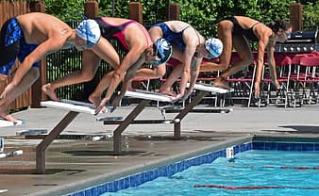
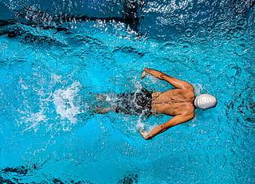
SWIM MEET SCHEDULE & DETAILS
Concessions will be served as a fundraiser for the Otters at each home meet (away meets have concessions as well). We do ask families to contribute to our Otter Cafe, either through a cash donation of $50 at the beginning of the season (money will be used to purchase food and drink for concessions), or by donating food or drink items (they can be homemade) to sell at each home meet. No donations are needed for away meets.
Concessions can be paid for with cash or by Venmo. Away meets are likely cash only.
49
50

Slide 28
INCLEMENT WEATHER
Inclement Weather General Protocol
As you can imagine, the weather can wreak havoc on our summer swim practices and meets.
First and foremost, the safety of our swimmers and their families is always our main concern.
The lifeguards on duty, along with coaches, at any practice or meet are the ones that make the call to clear the pool for thunder or lightning. If thunder or lightning have been reported, all patrons must clear the pool deck for 30 minutes (from the last weather offense).
Practice Specific Weather Protocol
It is rare that practice is canceled ahead of time due to weather, unless an impending storm is imminent. Old Church is in a very unpredictable pocket for weather, and often what is happening in the surrounding areas is not occurring in Old Church. It is always the goal to be able to have practice, even if it is shortened or age groups are combined.
Keep Swimming To the Next Page for More Info
51
52
CLICK HERE

Slide 29
INCLEMENT WEATHER
Swim Meet Inclement Weather Protocol
It is always the goal of the meet officials to complete the meet on the scheduled day, therefore all swimmers should arrive for the meet at the designated time, regardless of weather conditions.
Often times, a delay may mean sitting out a storm in your vehicle and waiting for it to pass so we, or the opposing team, do not have to return the following day to complete the meet.
Please note, Old Church Road can be dangerous when storms hit, as there is the potential for standing water and downed tree limbs. Please use your discretion when making decisions for your swimmers - especially swimmers that will be driving themselves or others.
Keep Swimming To the Next Page for More Info
53
54
CLICK HERE

Slide 30
INCLEMENT WEATHER
Warm up and relays can be canceled in order to shorten the meet, however all individual events must be swam for a meet to count.
The meet referee, coaches and parent rep work very hard in challenging weather conditions to make the best decision for all involved.
It is very challenging to rework a meet on a different day due to all people involved, from the coaches, to the swimmers and parent volunteers and the facility requirements. Please understand there are many factors that play into weather decisions and GRAL does have some established rules that must be followed.
If a weather delay occurs, Please wait in your vehicles or in the clubhouse for further instructions. All official communication on decisions will occur through email.
Keep Swimming To the Next Page for More Info
55
56
CLICK HERE

Slide 31
INCLEMENT WEATHER
Most of our meets occur on Wednesdays, but if there is a weather cancellation, Thursday is most likely the makeup date. It is very difficult to make up a meet on the weekends due to the pools being open to the general membership. Thank you for your patience during these challenging delays.
swim meet today
57
58

Slide 32
TIME TO VOLUNTEER
Work shifts are split into two halves.
First half volunteers must be on deck by 5:30pm and work through event 28.
Second half volunteers must be on deck immediately following event 28 through the end of the meet
If you only have and 8U swimmer, it is recommended that you volunteer for the first half so you can leave when your swimmer is done competing.
If your child is entered to swim in a meet, it is required that one parent volunteer their time for one half of every meet. Your child will not be permitted to swim in the meet until a parent/grandparent is signed up to work.
Swim meets are strictly volunteer run. It takes at least 60 volunteers from OC alone to run a home meet.
Keep Swimming To the Next Page for More Info
59
60
CLICK HERE

Slide 33
TIME TO VOLUNTEER
Referee
works the full meet
main responsibility is to ensure that the meet is conducted fairly
begins the meet once all requirements are met and teams and volunteers are in place
signs off on all disqualifications
hears any contests about disqualifications from both coaches,
has the ability to overrule judgments
must remain on deck through the end of the meet and until the meet is finalized
One person required at home meets, none at away meets.
Strokes and Turns
works one half of the meet
observes each race to determine whether the swimmers have performed the strokes legally
this position holds the unfortunate, however necessary, duty of disqualifying swimmers for performing illegal strokes
Four people required at each meet, home and away.
Certified Positions
Certified positions require you to take a short online class (a total of just a couple of hours of your time) and pass a test (you can look up the answers) before performing duties. Most of these training positions do require “walking/shadowing” for a couple meets as further training and allows you to ask questions and learn before being an official volunteer. We ask parents who have been on swim team for more than two years to consider fulfilling these roles.
Thank you for your understanding of this participation requirement.
Keep Swimming To the Next Page for More Info
61
62
CLICK HERE

Slide 34
TIME TO VOLUNTEER
Clerk of Course
works the full home meet
helps to organize all swimmers in their heats and lane for each event to help the meet run smoothly and remain on schedule.
Two people needed for home and away meets (away meets can be split into one person per half and you assist the other team as they are the main clerks).
Computer Rep
unofficial training required
works the whole meet at the computer table
sets up the meet, makes last minute entry changes, verifies and records times of each swim at the meet
updates the scores and finalizes the meet
submits results to GRAL
coordinates with the coaches prior to the meet and enters our home team entries into the system
informs the coaches of any mistakes as well
imports the opposing team’s entries and sets up the meet for home meets (prior to meet day, usually done on Monday evenings)
One main volunteer for the season to import entries and set up the meet, one additional volunteer needed for home meets to assist. Main volunteer
also works away meets to assist the home team.
Head Table Worker
works half the meet to help verify results
label and file ribbons for each swim
Four volunteers needed for home and away meets.
Only Head Table worker needs to be certified.
Starter
works half the meet
calls each event up to the block and ensures a fair and legal start of each race
Two volunteers required for home meets, none for away meets.
Keep Swimming To the Next Page for More Info
63
64
CLICK HERE

Slide 35
TIME TO VOLUNTEER
Check In Coordinator
must arrive at home and away meets prior to the official team check in time in order to sign in athletes as well as volunteers
hand out cards to each swimmer with their events (these will be pre-printed already)
One volunteer needed for each meet, home and away. This job is complete once all swimmers and volunteers are checked in.
Timers
works half the meet
presses start and stop on a stopwatch to get the time of each swimmer in each race.
22 volunteers needed for home meets, 16 for away meets.
Runner
works half of the meet
collects time and disqualification cards at the end of each heat to bring to the computer table for review
while it does not require running, it does involve a good amount of walking back and forth from one end of the pool to the other, every event
Two volunteers needed for home meets, none for away.
Non-Certified Positions
These positions require no GRAL training or course work.
Meet Director
responsible for arranging meet set up for the home club pool deck
coordinates all officials to run the meet efficiently
oversees that all required equipment and materials are available before the meet, including arrangements for the pool, pool deck, deck officials, starter and announcer, Clerk of Course, computer area, check-in tables and the table workers
ensures adequate lighting is a available for all stations and night swimming
One volunteer needed for each HOME meet and must arrive at Old Church at 4pm.
Meet Set Up Crew
must arrive at the HOME meet at 4pm
help set up the pool for the meet (this includes running the speakers and power, setting up flags and ropes around the pool, putting in blocks, setting up clerk of course, and other miscellaneous things that need to be done.
Two volunteers needed for home meets, none for away.
Keep Swimming To the Next Page for More Info
65
66
CLICK HERE

Slide 36
TIME TO VOLUNTEER
PLEASE NOTE
Volunteer positions that have volunteers not on the pool deck do allow the volunteer to leave and watch their child swim in an event and then return to volunteering.
It takes 60+ volunteers from our team if no one works both halves of the meet (except the referee).
As a team, we usually have about 55 families total, and that is only if every family attends every meet. So, as you can imagine, it is impossible to run an efficient meet without the help and volunteering from EVERY SINGLE FAMILY. Please know that we understand the challenges of watching younger children or only having one parent be able to attend a meet, however, to be a part of this team, it is a requirement to volunteer at every meet your child swims in.
Table Helpers
works half the meet
helps verify results
helps label and file ribbons for each swim
Four volunteers needed for home and away meets.
Concessions
works half the meet
helps with set or break down of the Otter Cafe
ensure distribution flow of food during the course of the meet
determine purchase totals & collects money from customers
6 volunteers needed for home meets, none for away.
Clean Up Crew
must stay upon the completion of the swim meet to make sure the pool deck is clear of all trash and tables and chairs are replaced in their original spots
help break down the pool by replacing ladders, pulling lane lines and dropping the flags, breaking down sound equipment and power as well as putting the pool ropes away (for home meets only)
Four volunteers are needed for home meets, two for away meets.
Keep Swimming To the Next Page for More Info
67
68
CLICK HERE

Slide 37
TIME TO VOLUNTEER
GRAL Representative
Otter representative to GRAL
attends virtual monthly meetings
maintains communications between GRAL and the swim team
delivers team registration and fees to GRAL
One volunteer needed for the entire year.
Parent Representative
coordinates with the opposing team by sending out the meet invitation to the visiting team as well as forwards the meet invitation to our team when we have an away meet (The meet invitation is a pre-set template that just has the updated information for each meet, including check in times, directions, pool information, etc.).
responsible for communication with the coaches and meet referee in deciding weather delays and rescheduling of meets
One volunteer needed for the entire summer season.
Head of Concessions
plans, purchases and sells concessions for the Otter Cafe (huge team fundraiser).
One volunteer needed for the entire summer season.
Swim Team Volunteer Positions
The Otters have an unofficial board which is composed of volunteers who fulfill one of several roles available. Please let the head coach or Board Liaison know if you have any questions or would like to fulfill one of these roles.
Board Liaison
An official Old Church Community Center Board member
attends monthly OCCC Board meetings
communicates with the swim team board and is the point person of contact for swim team (3 year term)
Computer Representative
inputs registration data at the start of the season
imports meet entries for each meet and uses the team software to create the meet
updates the data of each event throughout the meet
submits meet results to GRAL for verification
Keep Swimming To the Next Page for More Info
69
70
CLICK HERE

Slide 38
TIME TO VOLUNTEER
The swim team board always accepts volunteers and has other roles available as well:
ording team t-shirts
arranging for trophies/medals/plaques
coordinating team banquet
Volunteer Coordinator
works each meet to coordinate and fill volunteer positions for every home and away meet through paper sign ups and Sign-Up Genius.
One volunteer needed for the entire summer season.
Champs Coordinator
helps coordinate all things Champs related
required by GRAL to attend a coordinator meeting toward the end of the season, before Champs
in charge of designing and ordering t-shirts and caps for Champs qualifiers
distributes Champs information to all qualifiers
coordinates things with the coaches to help Champs run smoothly
One volunteer needed the last 3 weeks of the season and must attend the Champs meet as well.
we appreciate our volunteers!
71
72

Slide 39
CONCESSIONS
This is a huge source of income for our swim team, and is only made possible by the donations of swim team families.
Meet Concessions
Every meet offers concessions to the athletes and families. We have three home meets each season in which the Otter Cafe operates in the clubhouse.
For away meets, concession donations are not required.
Keep Swimming To the Next Page for More Info
73
74
CLICK HERE

Slide 40
CONCESSIONS
Option Two: Food Donations
required for each home meet
may provide store bought or homemade items (pasta salad, cut fruit, baked goods, etc.)
Homemade goods add a personal touch to the food options we offer in the Otter Cafe, and are ALWAYS hot items that sell quickly!
If you have the time and enjoy cooking, please consider this option for concession donations.
A Sign Up Genius will be shared prior to each home meet for families choosing option 2 to sign up for concession donations.
Concession Donations Options
Each family is asked to pick one of the following donation options for concessions:
Option One: $50 donation
a one time donation due by the last day of regular registration (May 31, 2023)
goes toward the purchase of chips, drinks, snacks, pizza, and Chick-Fil-a to sell in the Otter Cafe
Keep Swimming To the Next Page for More Info
75
76
CLICK HERE

Slide 41
CONCESSIONS
Chips TBD
Candy TBD
Fresh Fruit (Bowl) TBD
Cookies / Brownies TBD
Pasta Salad (Bowl) TBD
Drinks TBD
(soda, small Gatorade, water)
Cash & Venmo Accepted
*IF PAYING IN CASH, PLEASE USE SMALL BILLS*
The Otter Cafe Menu
Chick-Fil-A Sandwich TBD
(PRE-ORDER ONLY)
Chick-Fil-A 5 Count Nugget TBD
(PRE-ORDER ONLY)
Pizze (By the Slice) TBD
(cheese or pepperoni)
(PRE-ORDER ONLY)
Hamburgers TBD
Hot Dogs TBD
Keep Swimming To the Next Page for More Info
77
78
CLICK HERE

Slide 42
CONCESSIONS
You can pre-order these items by clicking on the image below to access the Google Form:
Otter Cafe Pre-Orders
This year for each home swim meet, you can pre-order the following food items:
Chick-Fil-A Chicken Sandwich
Chick-Fil-A 5 Count Nugget
Cheese Pizza
Pepperoni Pizza
Venmo Payment Must Be Received By 10 AM On The Tuesday Before the Swim Meet
Cash Payments Due At Pick-Up
All pre-ordered food items should be picked up from the Otter Cafe by the end of the first half of the swim meet.
79
80

Slide 43
LET’S CELEBRATE
Fun Fridays
Every Friday 9:30 - 10:15 AM
Come celebrate with the team as they gather for breakfast after an optional shortened morning practice. Coaches will highlight notable swims from the week, recognize achievements, and hand out ribbons from the week’s meet.
Each family attending is asked to donate an item to the team breakfast (juice, fruit or doughnuts).
Your child does not have to attend the morning practice on Friday in order to come to the ceremony. Friday practice and Ribbon Ceremony are completely optional.
Bigs & Littles
The Old Church Otters swimmers participate in a Big Brother/Sister program each summer. Each 10 and under swimmer is paired with an older swimmer for the season. The goal of this program is to build relationships between the older and younger swimmers on the team, as well as allowing younger kids to have someone to look up to, learn from, and be cheered on at meets. While each year swimmers are assigned new Big & Littles, it is our hope that the relationships will continue through the years on the team.
Ways to Support Your Big/Little
Make a sign to give them at each meet
Bring them a snack or candy at each meet
Bring them a drink at each meet
Cheer them on when they swim
Interact during practice and swim meets
Keep Swimming To the Next Page for More Info
81
82
CLICK HERE

Slide 44
LET’S CELEBRATE
Swim Team Banquet
July 27, 2023 6PM
Come celebrate a successful 2023 summer swim season! The pool is open to swimmers as well as the membership at this time, so feel free to bring your swimsuit.
Each family participating is asked to bring a (side dish or dessert to share). The team will provide the main dish and a cake. Coaches will recap the season, share some awards with the swimmers, and hand out team trophies/medals/plaques.
Team Pictures
June 27, 2023 6PM
Say cheese! Come be a part of the team photo and take advantage of having your swimmer(s) photographed. Packages available. Pricing will be shared prior to the date.
Swim-A-Thon
June 27, 2023 7:00 - 8:00PM
Help raise money for the OC Otters by swimming! Swim team members collect flat pledges or pledges per lap. They then swim, swim, swim to see how much they can raise for the swim team! This is such a fun time for all and a great
way to support the
team!
83
84

Slide 45
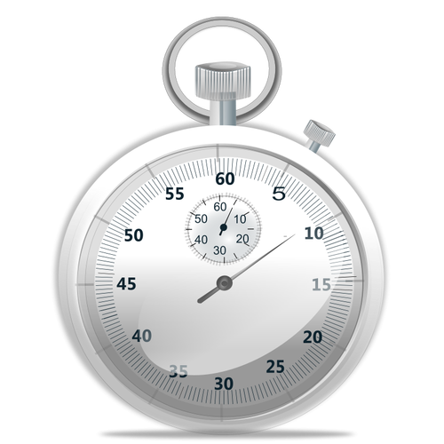
TIME STANDARDS
DID YOU KNOW?
There are 5 age groups
8 years and Under
9-10 year olds
11-12 year olds
13-14 year olds
15-18 year olds
Old Church is a YARD pool
There are 5 divisions of time standards for
each age group
each event, male and female
both meters and yards (each pool varies either 25 yards or 25 meters).
UNDERSTANDING SWIM MEET TIME STANDARDS
GRAL has an established set time standards which are modified every two years.
Time standards can be found at:
2023 Time Standards (gralva.com)
Keep Swimming To the Next Page for More Info
85
86
CLICK HERE

Slide 46
TIME STANDARDS
Divisions are
Novice (N)
(anything slower than the Advance Standard)
Advance (ADV)
Junior Varsity (JV)
Varsity (V)
Senior Varsity (SV)
It takes a Junior Varsity, Varsity or Senior Varsity time standard to automatically qualify for Champs.
87
88

Slide 47
READING THE RESULTS
Results will be posted at each meet and final results will be emailed once the meet has been verified by GRAL.
Each swimmer earns points in the division they were listed at when they entered that particular meet. If they swim a faster time and move up a division, you will see that in the results, and the following meet, they will be entered and scored in their new division standard.
Entry times will always be the fastest time the swimmer has had in the past 2 years. If they swim slower one meet, their faster time will still be used as their entry time.
GRAL scores 6 places deep in all divisions in all individual events. Due to there being 5 divisions in each age group of each event at meets, it is possible to have -
5 first place finishes
in the same age group (one per division)
5 second place finishes
in the same age group (one per division)
5 thirds place finishes
in the same age group (one per division)
5 fourth place finishes
in the same age group (one per division)
5 fifth place finishes
in the same age group (one per division)
5 sixth place finishes
in the same age group (one per division)
Keep Swimming To the Next Page for More Info
89
90
CLICK HERE

Slide 48
READING THE RESULTS
CLICK ON THE MAGNIFYING GLASS TO LEARN MORE ABOUT EACH PART OF THE RESULTS RECORD
AGE GROUP
DISTANCE SWAM
SC = SHORT COURSE
UNIT OF MEASURE
STROKE
EVENT #
SEED TIME
- the entry time (fastest time swam by the swimmer in that
event in last 2 years)
- NT will mean No Time (the athlete has not completed the
swim in that distance, in an individual event legally yet)
SWIMMER’S GENDER
TIME STANDARDS BY DIVISION
FAST, BRIANNA
DIVER, DEEPSY
WAVE, AQUA
FINS, SILVER
DIVISION SWIMMER ENTERED IN
FINISHING PLACE AFTER MEET VERIFICATION
TIME THE SWIMMER SWAM THE EVENT & DIVISION THAT TIME ALIGNS WITH
POINTS EARNED TOWARD TEAM TOTAL
Keep Swimming To the Next Page for More Info
91
92
CLICK HERE

Slide 49
READING THE RESULTS
This swimmers final time placed her fourth overall, however, since she was in a different division from all other athletes, she earned a first place finish in her novice division.
CLARIFYING THE RESULTS
This is an example of how 4 swimmers in the same event all earned first place and therefore each earn 7 points for their team.
FAST, BRIANNA
DIVER, DEEPSY
WAVE, AQUA
FINS, SILVER
In this event, this swimmer swam the fastest time overall. So, when watching the race, she beat all of the other swimmers. However, she is the second swimmer listed because she entered the meet with a Junior Varsity time and the swimmer above her entered with a Varsity time. Each is scored in their respective divisions.
For this swimmer, her final time is faster than the first swimmer listed. This swimmer came in second overall, however, due to the fact that she entered the meet in the advanced division, she placed first and earned points for the team in the advance division.
Keep Swimming To the Next Page for More Info
93
94
CLICK HERE

Slide 50
READING THE RESULTS
The coaches receive DQ cards at the end of the meet. If a swimmer is disqualified, they will not receive a time or placing in the meet. It is the responsibility of the coaches to meet with swimmers (and probably their parents) and explain what the infraction was and how to address it.
Generally, the coaches will not enter a swimmer in an event if they are not legal in the stroke. If the swimmer is close to legal, or is occasionally legal, the coach may enter them to see how they do.
UNDERSTANDING DISQUALIFICATION
Each stroke and each event has set standards as determined by USA Swimming and GRAL of how the stroke must be swam.
The Strokes and Turns Judges are tasked with watching each swim in their zone and looking for infractions. If a judge spots an infraction, they will raise their hand and discuss it with the Meet Referee. If it is decided that the infraction stands, a DQ card will be written out with the swimmer name, event and infraction.
Keep Swimming To the Next Page for More Info
95
96
CLICK HERE

Slide 51
READING THE RESULTS
This swimmer entered the meet with no time in this event (NT = has not legally completed this stroke in this distance, individually). He did not complete the swim legally in this meet, which means he disqualified his event (DQ). He does not earn a time or a placement in this event and his coach will receive a DQ card explaining his infraction. He and his coach will address the issue.
Sometimes a swimmer just really wants to swim an event, even if they aren’t legal, and the coach may enter them. Sometimes the coach has more faith in a swimmer's ability than the swimmer has in himself, and the coach may enter him in an event to encourage building confidence, breaking down mental barriers and pushing limits.
98
QUICK, BARRY
97
SPEEDER, JOHN
Keep Swimming To the Next Page for More Info
MERMAN, SHAWN
MARINA, FISHER
CLICK HERE

Slide 52
READING THE RESULTS
Strokes and Turns Judges do not want to DQ kids, however, it is a necessary evil. If the swimmer performs an infraction once, the judge will likely let it go (they will look away to another swimmer and pretend they didn’t see it). When the judge looks back, if the infraction is repeated, the swimmer will get DQed.
All stroke rules apply to all ages. This means an 8 year old is held to the same standard of legality as an 18 year old swimmer.
THINGS TO CONSIDER
Please have your swimmer find a time to meet with a coach to explain his/her infraction
DQ can be a painful and frustrating process, for swimmers and their parents. There are going to be tears, probably on both sides. However, it is a great opportunity to learn and grow and really understand the breakdown of the stroke, and an opportunity to improve.
99
100

Slide 53
CHAMPS
CHAMPS FYIs
Swimmers may qualify in any event at any of the six regular season meets.
Swimmers may not qualify for an individual event through a relay swim.
Teams are allowed to build relays at Champs with non-qualified swimmers, as long as one swimmer on the relay is a qualifier in the stroke they swim on that relay. (EX: If we only have one swimmer qualify in the 50 fly in 11-12 age group, we can still make a 200 Medley relay by bringing 3 non-qualifiers to fill out the rest of the relay, as long as the qualified swimmer is the fly leg of that relay. Therefore, it is possible for a swimmer to swim at Champs without qualifying individually, however they would only be able to compete on the relays they are a part of.)
CHAMPS SWIM MEET
July 30-31, 2023
Hosted at SwimRVA in Chesterfield
Champs is a meet at the end of the summer in which swimmers must meet a qualifying standard in at least one individual event to attend (exception is relays).
The time standard is a Junior Varsity (JV) time or faster in the current season.
(see “Time Standards” section)
The meet alternates each year between being swum in yards and meters.
Keep Swimming To the Next Page for More Info
101
102
CLICK HERE

Slide 54
CHAMPS
Champs Practice
(qualifying swimmers & relay fillers)
TO BE DETERMINED
Champs t-shirts and caps may be purchased prior to Champs.
The 12 years and under swimmers compete on Saturday
13 year olds and up swimmers compete on Sunday
There are two sessions each day, and the relays are at the end of each session (Free in the morning session, Medley in the afternoon session).
Swimmers can swim up to 4 individual events and 2 relays.
103
104

Slide 55
SPONSORSHIPS
Participation in meet concessions, team pictures, purchasing team swag and team suits are all ways that the Otters incorporate fundraising into our team functions.
Sponsorship
We reach out to local businesses in the community to seek sponsorship donations. If you or your business are interested in supporting the Otters, please let the board liaison know or you can find more information on the Old Church Community Center website (https://www.oldchurchcc.com).
OCCC is 501C and donations are tax deductible.
Team Funding
The Otter swim team is a small, self-funded community within Old Church Community Center. The money that we raise through fundraising and sponsorships, along with registration fees, is what keeps our program running. Fundraisers are built into the everyday happenings of the team for the most part, however we do a swim-a-thon annually as well as some other activities occasionally (Papa John’s orders, spirit nights, etc.).
105
106

Slide 56
Thank you!
On behalf of all of the OC Otters, we thank you in advance for all you will do to help make this swim season a success!
Go Otters!
107

